Slide 1

Piracy Why and How
Hamtalk (Karaj)
29 Oct 2023
Nikan Doosti

Slide 2
Let’s play a game
I show you the thumbnail of a video
It has the following information:
Release year
Number of views
Number of likes
You should guess if the video is appreciated by the community
I show you the dislikes as a (good) metric of community feedback

Slide 4
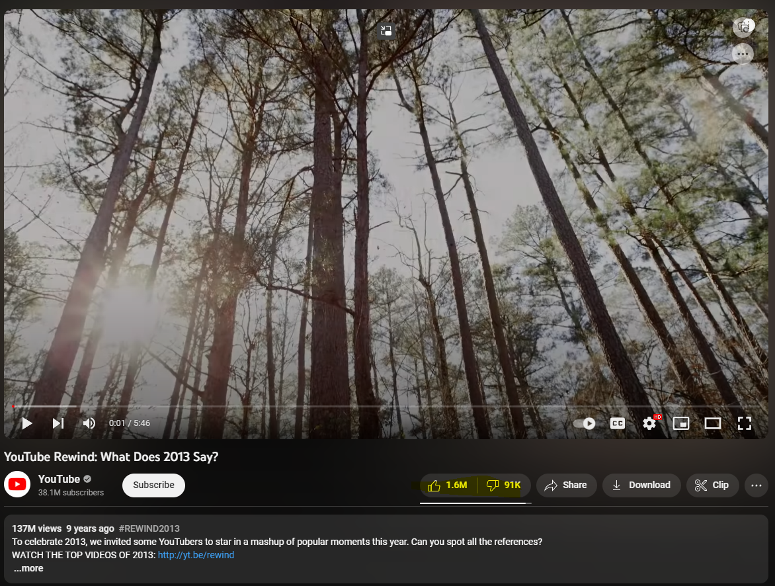
?

Slide 7

?

Slide 10
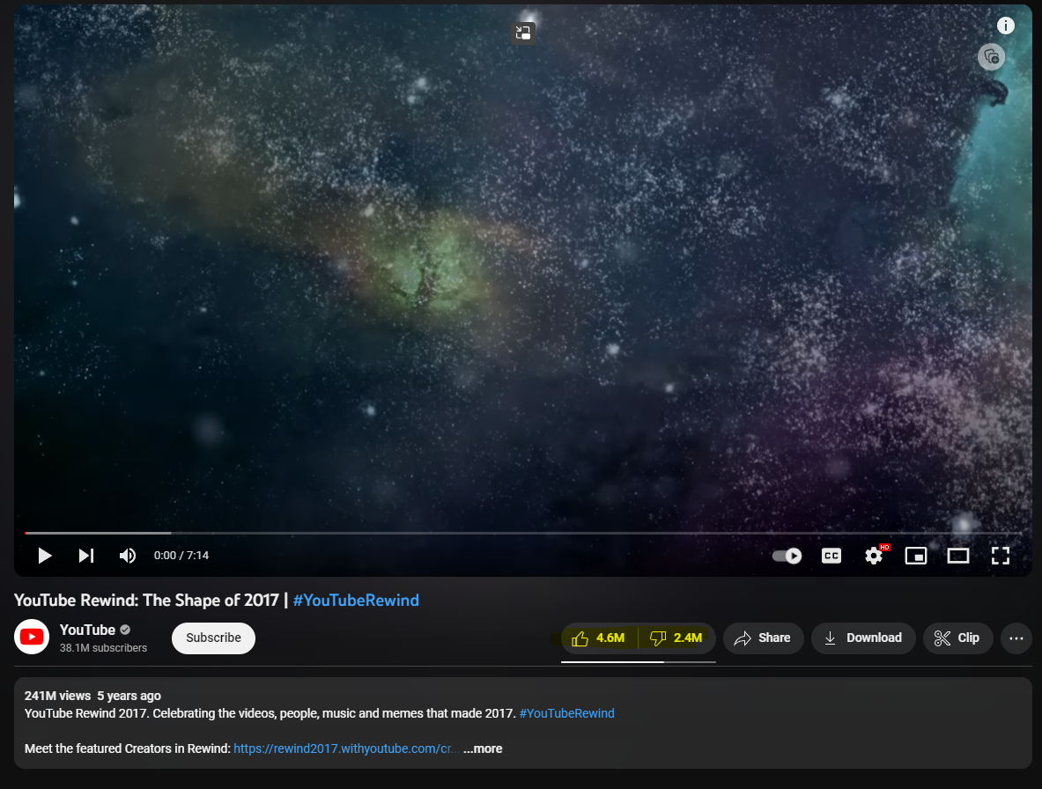
?

Slide 13
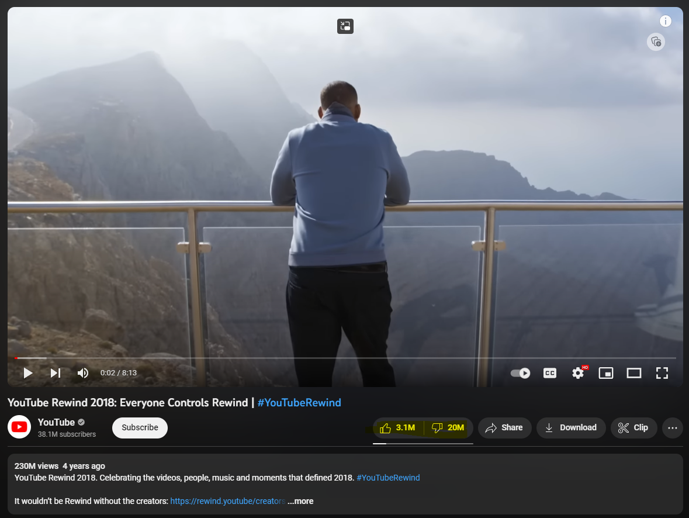
?

Slide 16
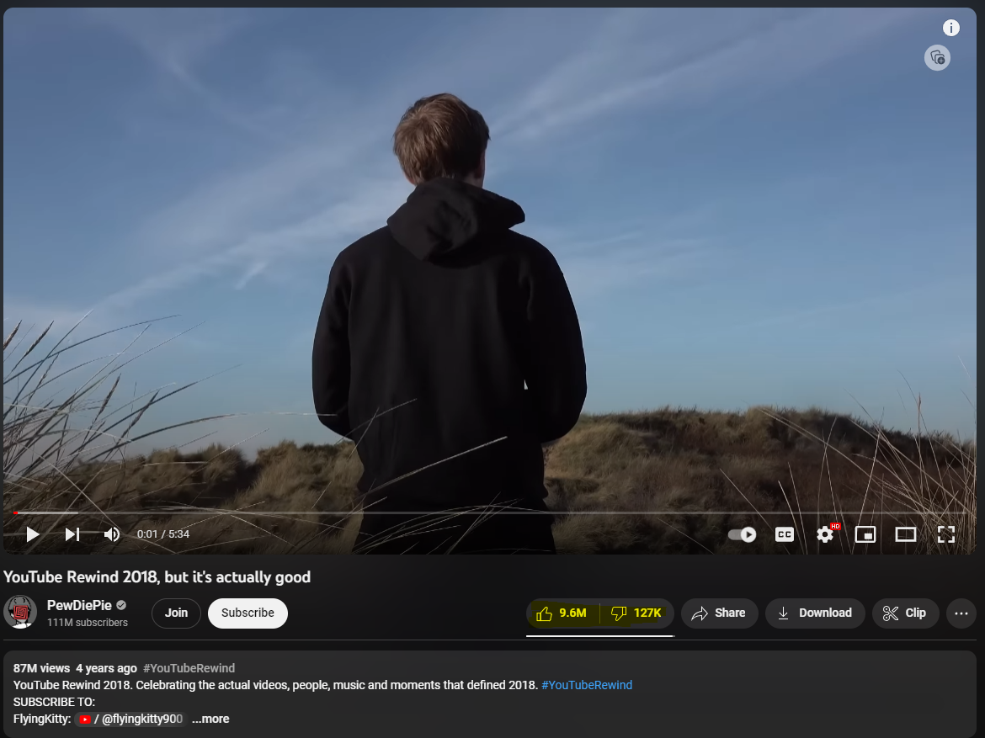
?

Slide 19


Slide 21
It actually happened!!!

Slide 23
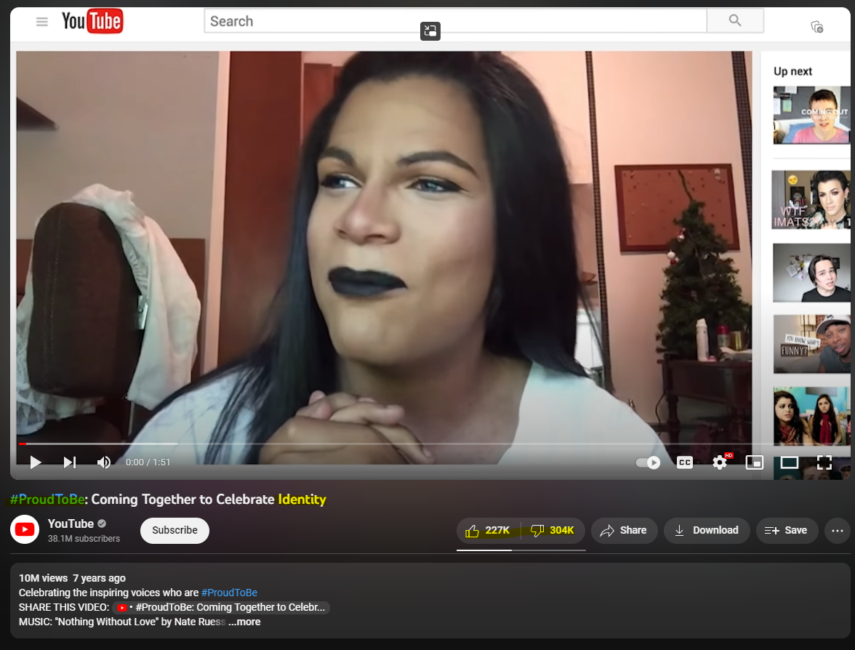
?

Slide 25
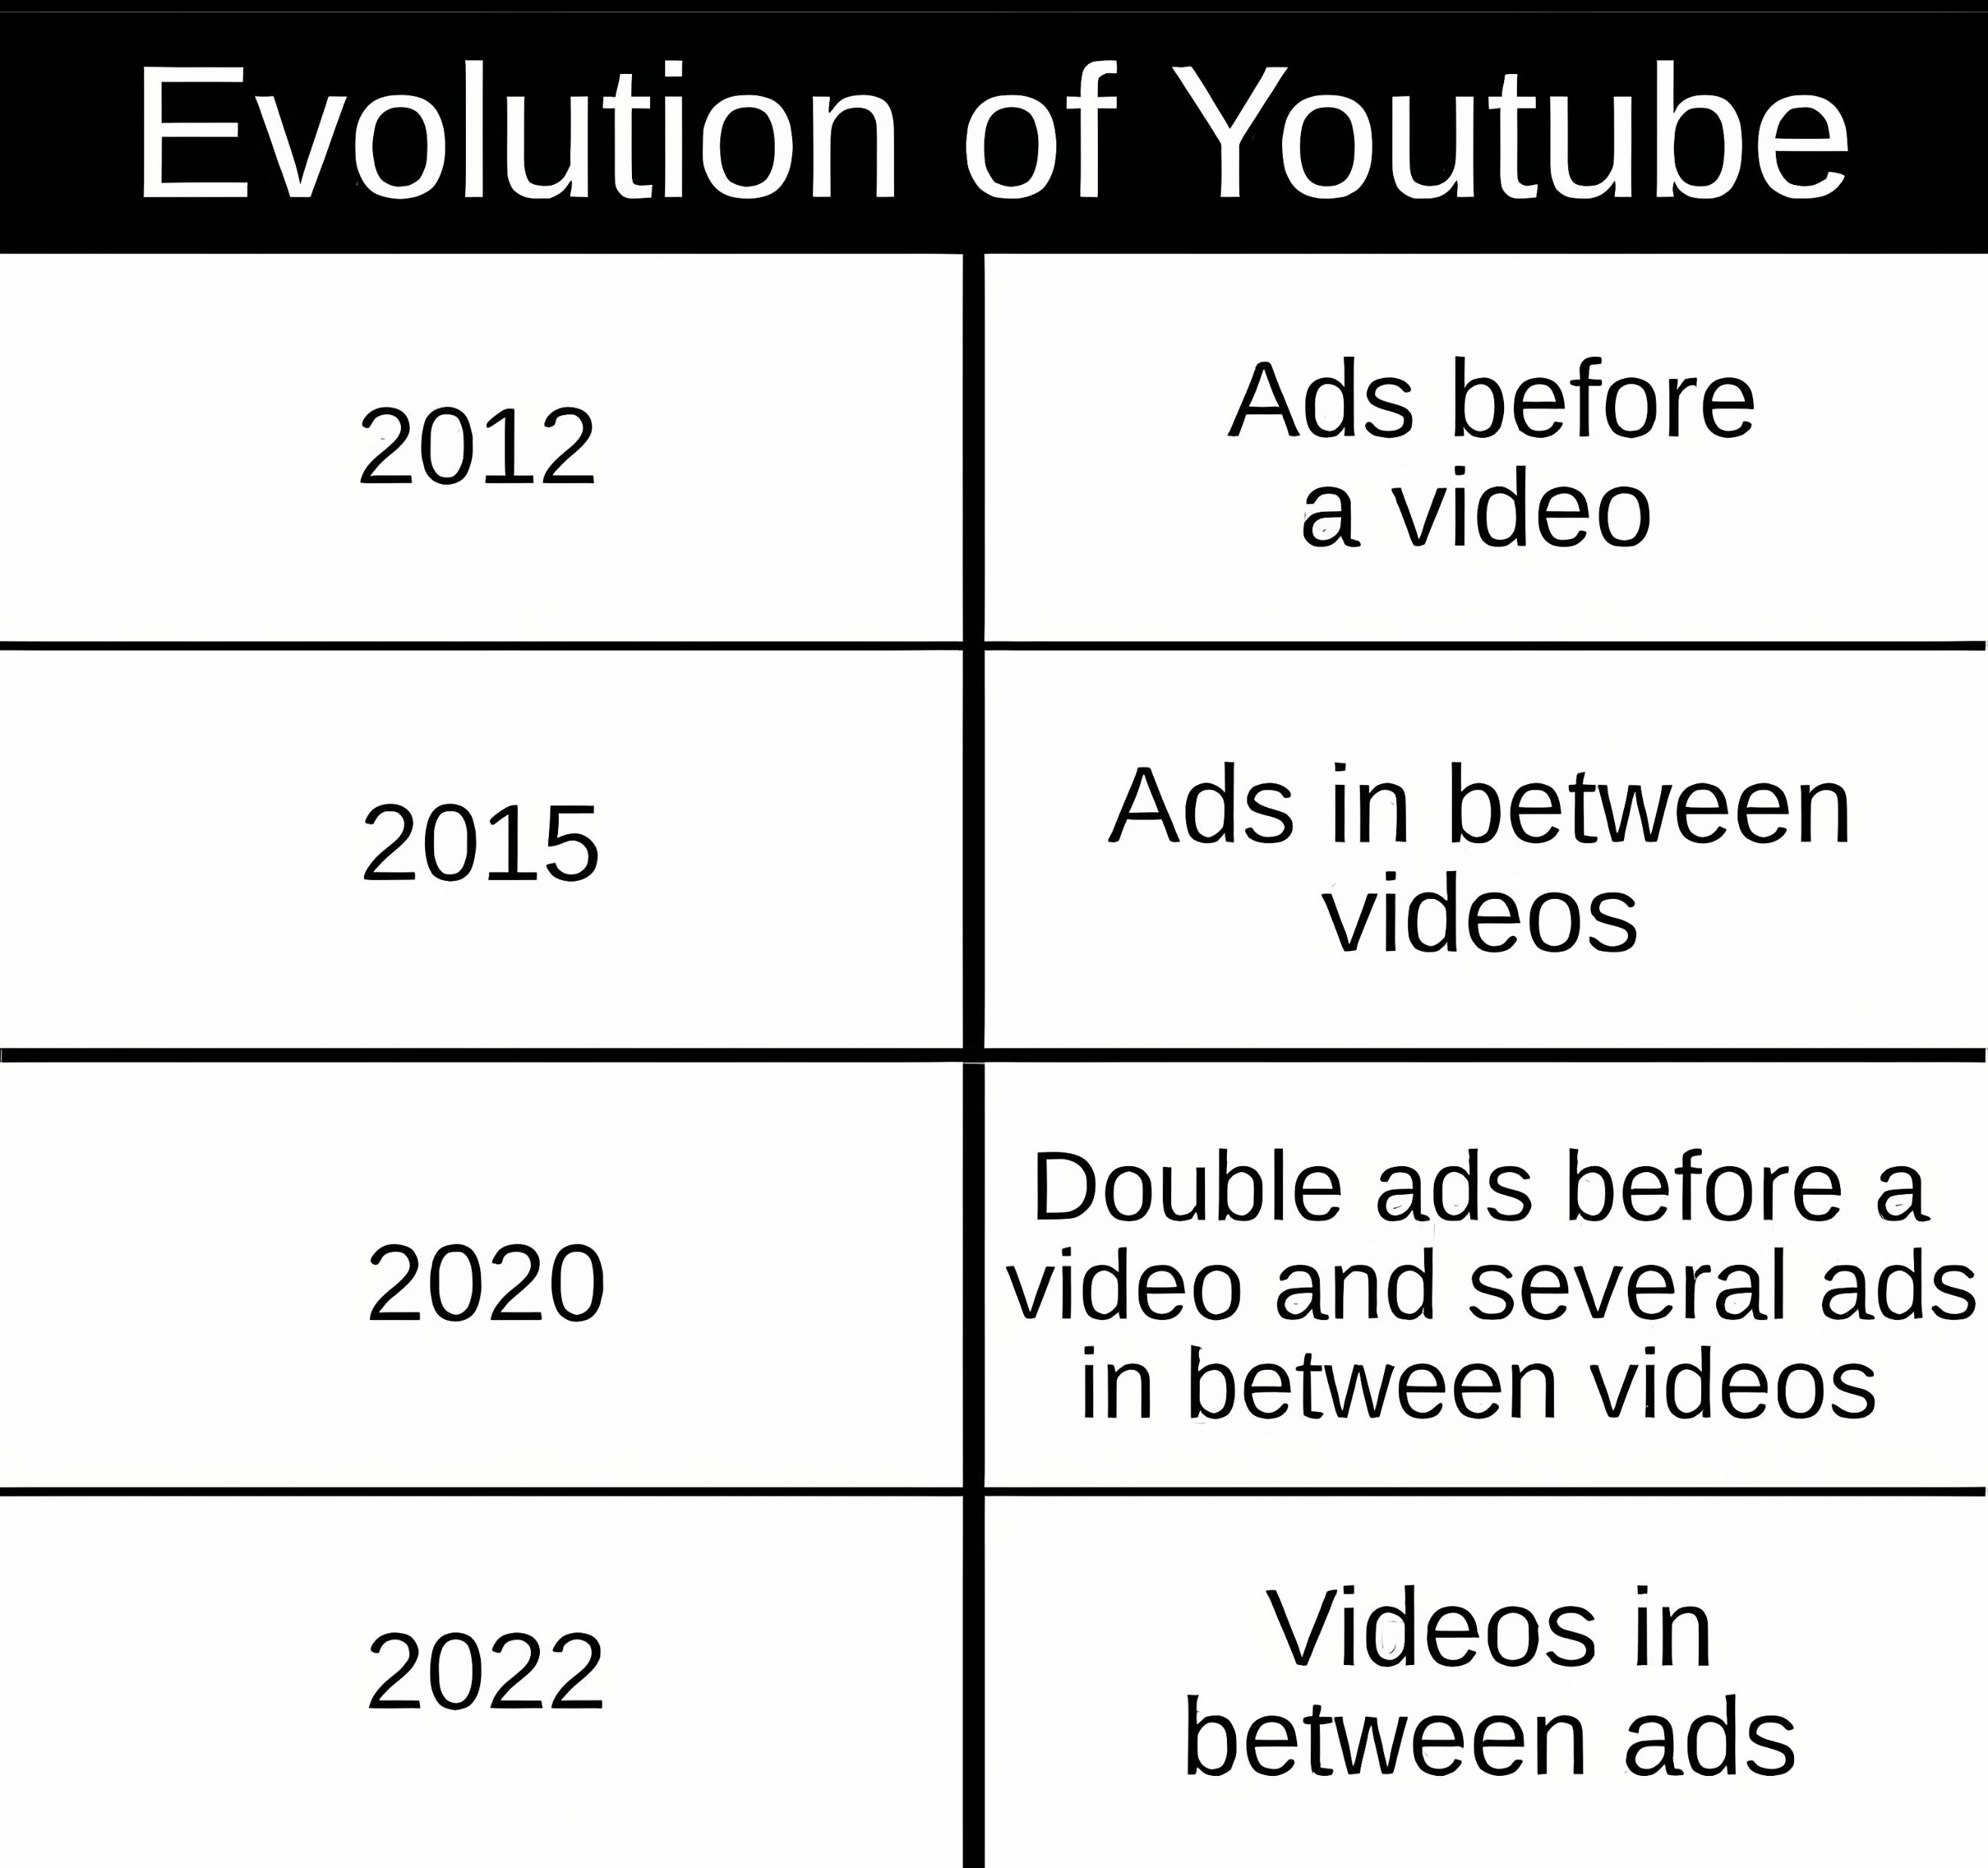

Slide 27
Free TV on Antenna
Has Commercials
Cable offers TV without Commercials (paid)
Cable starts airing commercials
Cable charges extra for bonus channels (HBO)
Cable starts packages (only one item is desired)

Slide 28

Free TV on Antenna
Has Commercials
Cable offers TV without Commercials (paid)
Cable starts airing commercials
Cable charges extra for bonus channels (HBO)
Cable starts packages (only one item is desired)

Slide 30
Streaming comes out
Offers free TV with commercials
Offers paid plans without commercials
Subscriptions become mandatory
Ads are shown even on paid plans
Exclusives on each service, requiring separate plans

Slide 31
Streaming comes out
Offers free TV with commercials
Offers paid plans without commercials
Subscriptions become mandatory
Ads are shown even on paid plans
Exclusives on each service, requiring separate plans

Slide 33
Free TV on Antenna
Has Commercials
Cable offers TV without Commercials (paid)
Cable starts airing commercials
Cable charges extra for bonus channels (HBO)
Cable starts packages (only one item is desired)
Streaming comes out
Offers free TV with commercials
Offers paid plans without commercials
Subscriptions become mandatory
Ads are shown even on paid plans
Exclusives on each service, requiring separate plans

Slide 34
How about science?
You might think this is just about the entertainment companies.
How about scientific publications? Books? Conferences? Journals?

Slide 35
Academic Publication
I have published a paper
All paid by the tax money (hosted in Germany) and my own
In total, from zero to publication, cost around $8000
When I wanted to publish this, I had the following options:
Free: have no rights, not me not the public, no one
Free*: Have some rights, but behind the paywall; $15 for the access
Paid: have some rights, and open access for the public; $400 one-time fee

Slide 36
Academic Publication
I have published a paper
All paid by the tax money (hosted in Germany) and my own
In total, from zero to publication, cost around $8000
When I wanted to publish this, I had the following options:
Free: have no rights, not me not the public, no one
Free*: Have some rights, but behind the paywall; $15 for the access
Paid: have some rights, and open access for the public; $400 one-time fee

Slide 37
Academic Publication
I have published a paper
All paid by the tax money (hosted in Germany) and my own
In total, from zero to publication, cost around $8000
When I wanted to publish this, I had the following options:
Free: have no rights, not me not the public, no one
Free*: Have some rights, but behind the paywall; $15 for the access
Paid: have some rights, and open access for the public; $400 one-time fee

Slide 38

Academic Publication
I have published a paper
All paid by the tax money (hosted in Germany) and my own
In total, from zero to publication, cost around $8000
When I wanted to publish this, I had the following options:
Free: have no rights, not me not the public, no one
Free*: Have some rights, but behind the paywall; $15 for the access
Paid: have some rights, and open access for the public; $400 one-time fee

Slide 39
The Problem

Slide 40
Notes:
For a mega-corporation like Microsoft this makes perfect sense. Not only is the education market immense and juicy in itself, but the prospect of shaping students into future workers, managers, and entrepreneurs that have literally and formally learnt to depend exclusively on their products must be irresistible.

Slide 41
Features
Time
Notes:
For a mega-corporation like Microsoft this makes perfect sense. Not only is the education market immense and juicy in itself, but the prospect of shaping students into future workers, managers, and entrepreneurs that have literally and formally learnt to depend exclusively on their products must be irresistible.

Slide 42
Features
Time
Notes:
For a mega-corporation like Microsoft this makes perfect sense. Not only is the education market immense and juicy in itself, but the prospect of shaping students into future workers, managers, and entrepreneurs that have literally and formally learnt to depend exclusively on their products must be irresistible.

Slide 43
Features
User standard
Time
Notes:
For a mega-corporation like Microsoft this makes perfect sense. Not only is the education market immense and juicy in itself, but the prospect of shaping students into future workers, managers, and entrepreneurs that have literally and formally learnt to depend exclusively on their products must be irresistible.

Slide 44
Wide spread adoption
Features
User standard
Time
Notes:
For a mega-corporation like Microsoft this makes perfect sense. Not only is the education market immense and juicy in itself, but the prospect of shaping students into future workers, managers, and entrepreneurs that have literally and formally learnt to depend exclusively on their products must be irresistible.

Slide 45
Wide spread adoption
Features
“standard” edition
User standard
Time
Notes:
For a mega-corporation like Microsoft this makes perfect sense. Not only is the education market immense and juicy in itself, but the prospect of shaping students into future workers, managers, and entrepreneurs that have literally and formally learnt to depend exclusively on their products must be irresistible.

Slide 46
Wide spread adoption
Features
“premium” edition
“standard” edition
User standard
Time
Notes:
For a mega-corporation like Microsoft this makes perfect sense. Not only is the education market immense and juicy in itself, but the prospect of shaping students into future workers, managers, and entrepreneurs that have literally and formally learnt to depend exclusively on their products must be irresistible.

Slide 47
Wide spread adoption
Features
“premium” edition
“standard” edition
User standard
Time
IT IS ALL THE SAME
As long as the publishing company is the copyright holder rather than the creator
Notes:
For a mega-corporation like Microsoft this makes perfect sense. Not only is the education market immense and juicy in itself, but the prospect of shaping students into future workers, managers, and entrepreneurs that have literally and formally learnt to depend exclusively on their products must be irresistible.

Slide 48
Wide spread adoption
Features
“premium” edition
“standard” edition
User standard
Time
IT IS ALL THE SAME
As long as the publishing company is the copyright holder rather than the creator
Solution
Notes:
For a mega-corporation like Microsoft this makes perfect sense. Not only is the education market immense and juicy in itself, but the prospect of shaping students into future workers, managers, and entrepreneurs that have literally and formally learnt to depend exclusively on their products must be irresistible.

Slide 49
Piracy can't be stealing, if paying for it isn't owning.

Slide 50
How does it work?

Slide 51
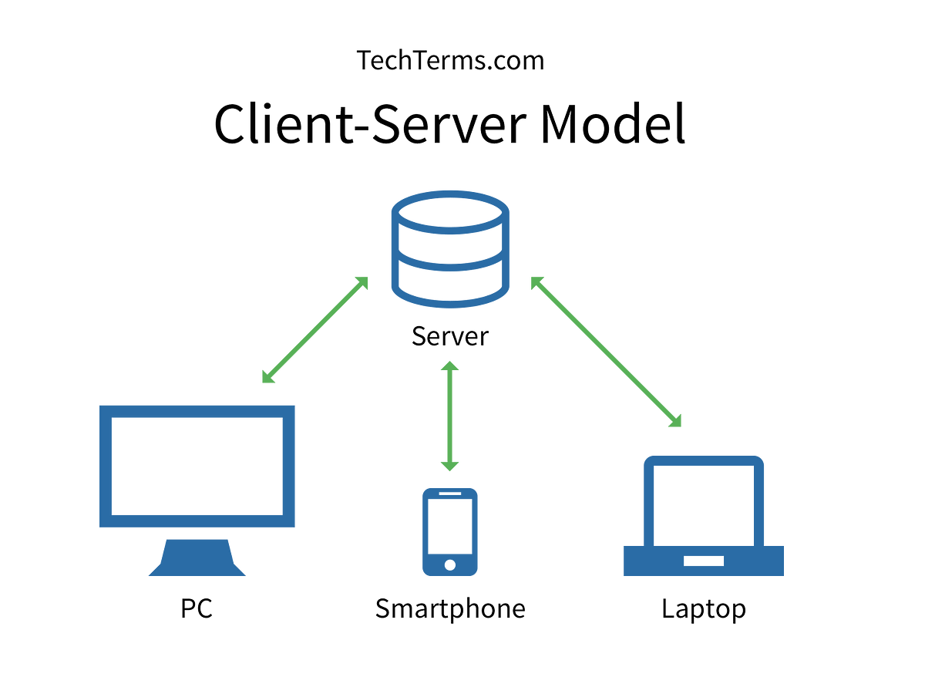

Slide 52
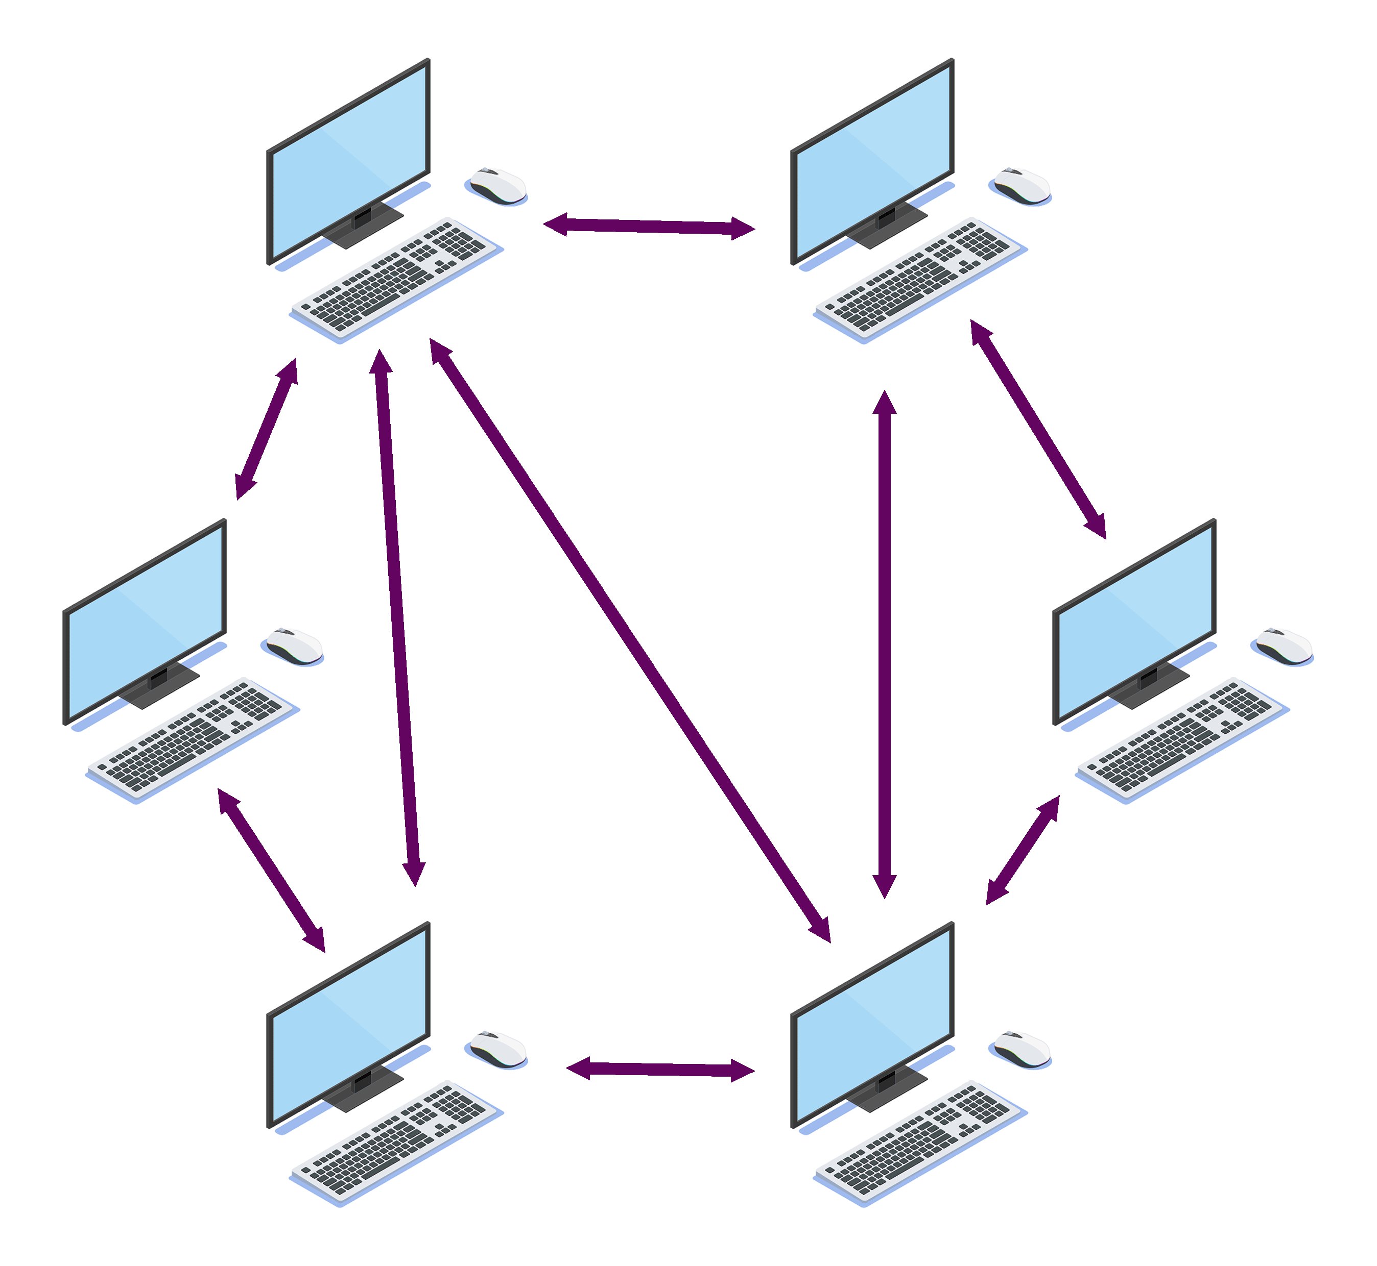
Peer-to-Peer Model

Slide 53
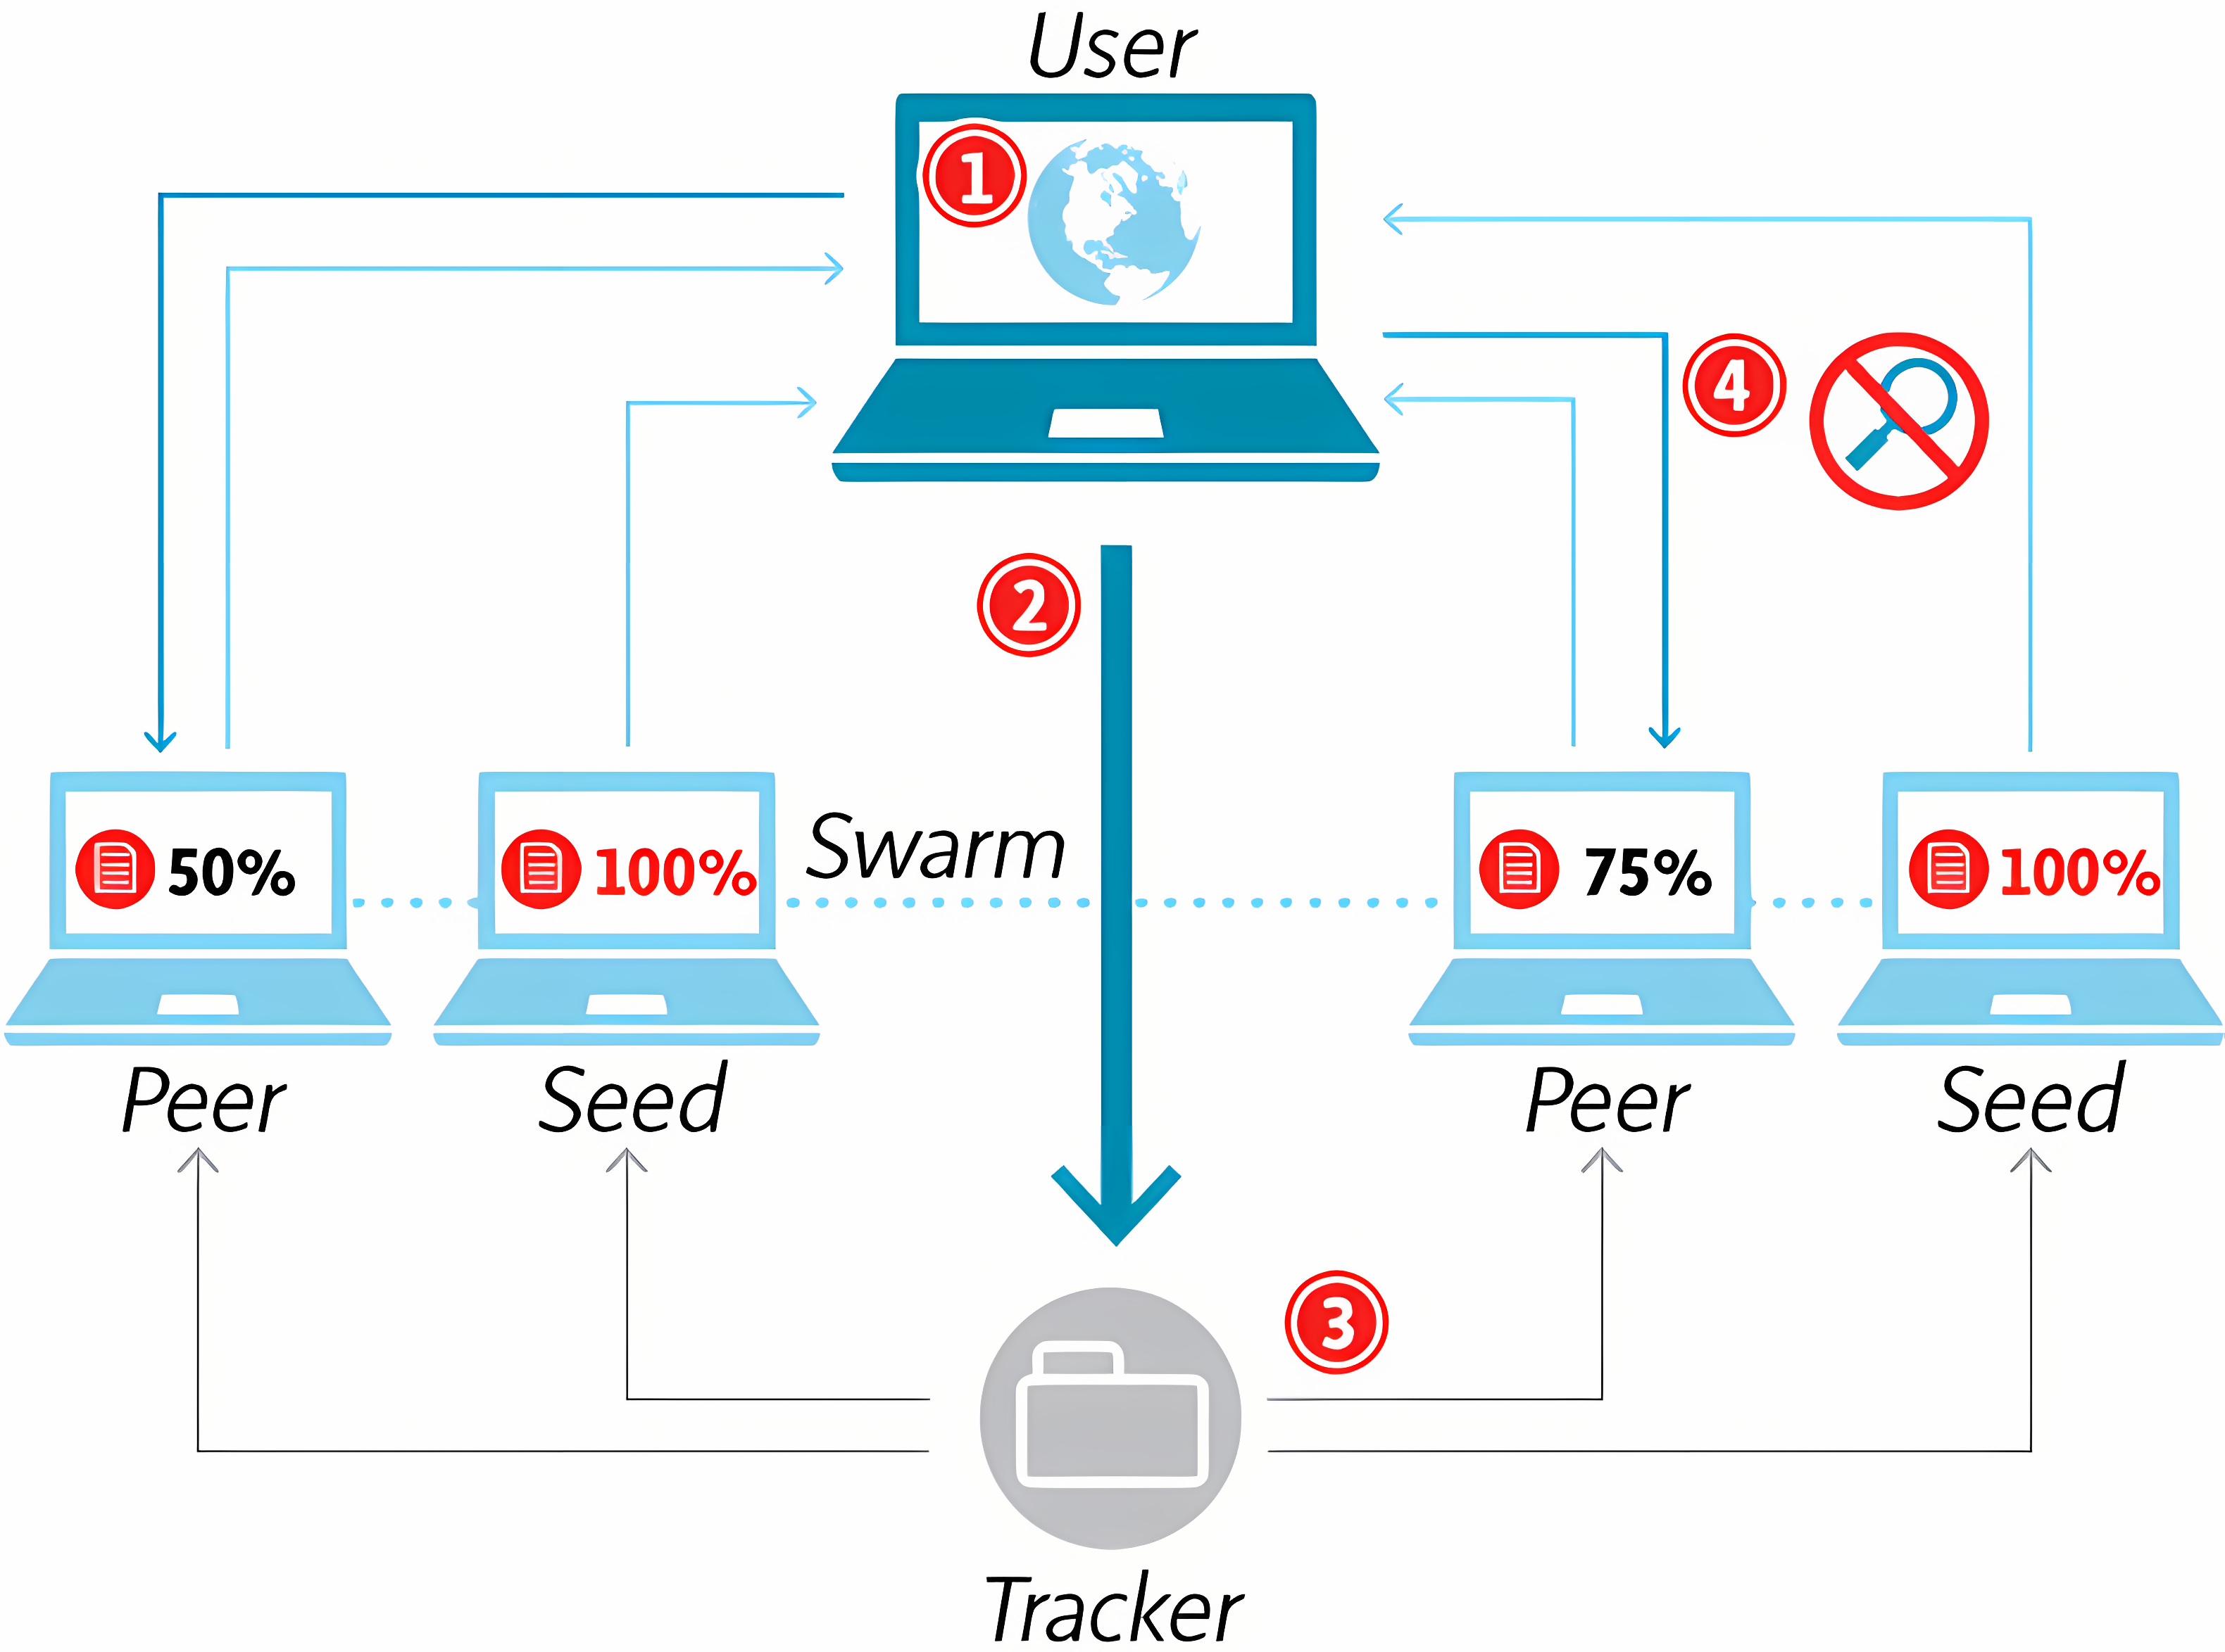
Torrenting

Slide 54
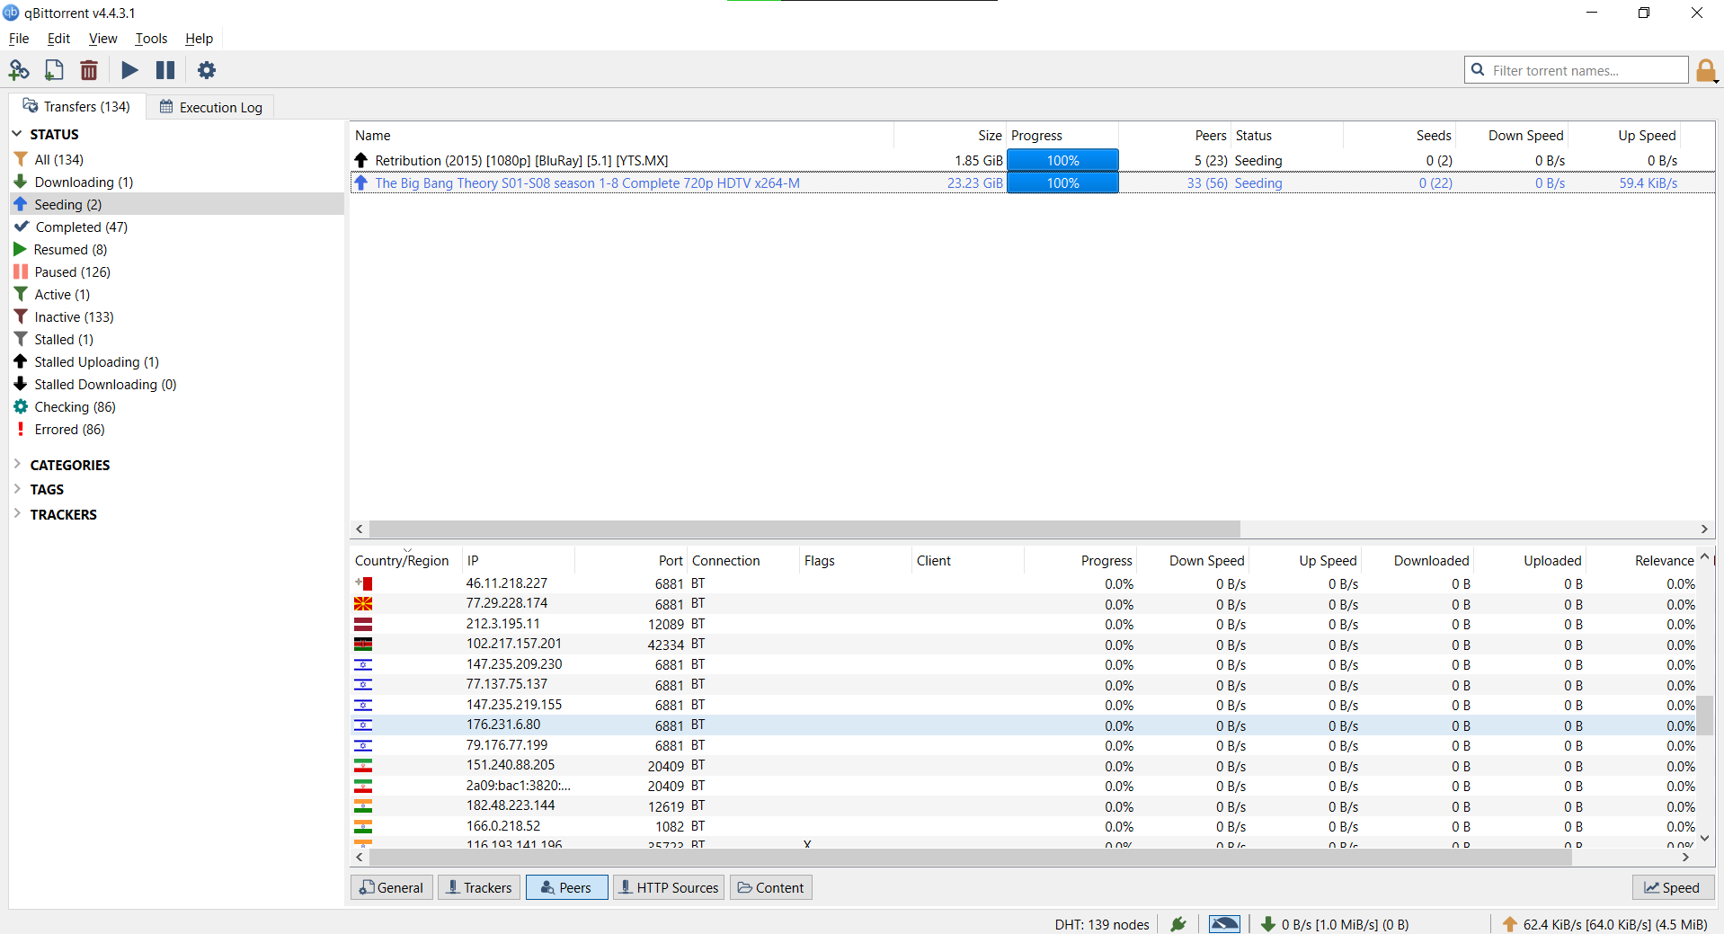

Slide 55
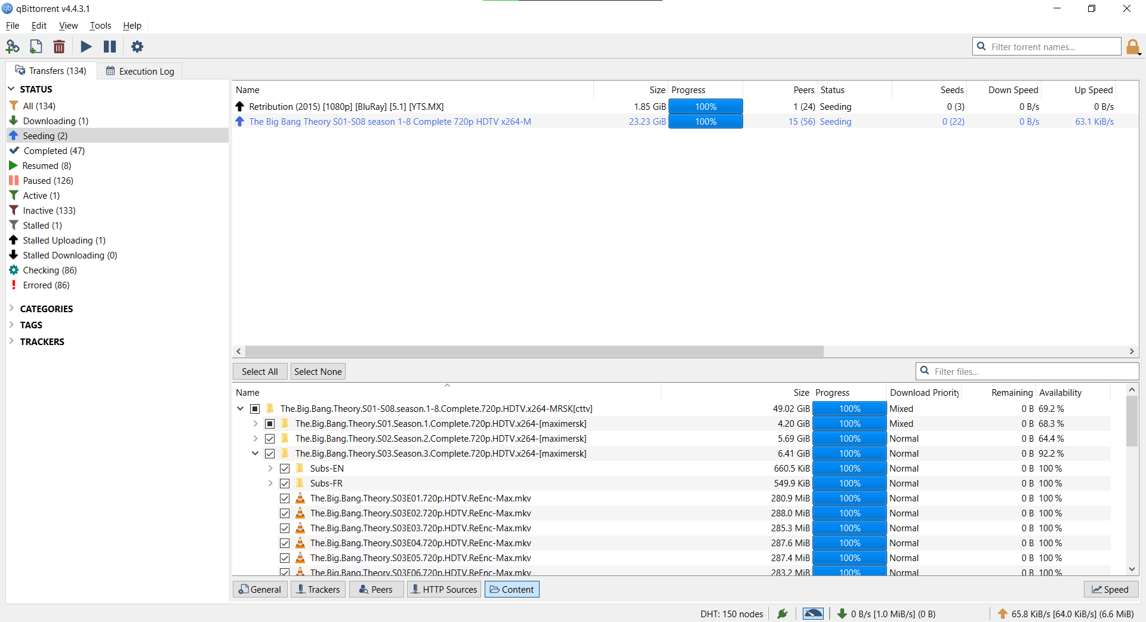

Slide 56
The goddamn DMCA

Slide 57
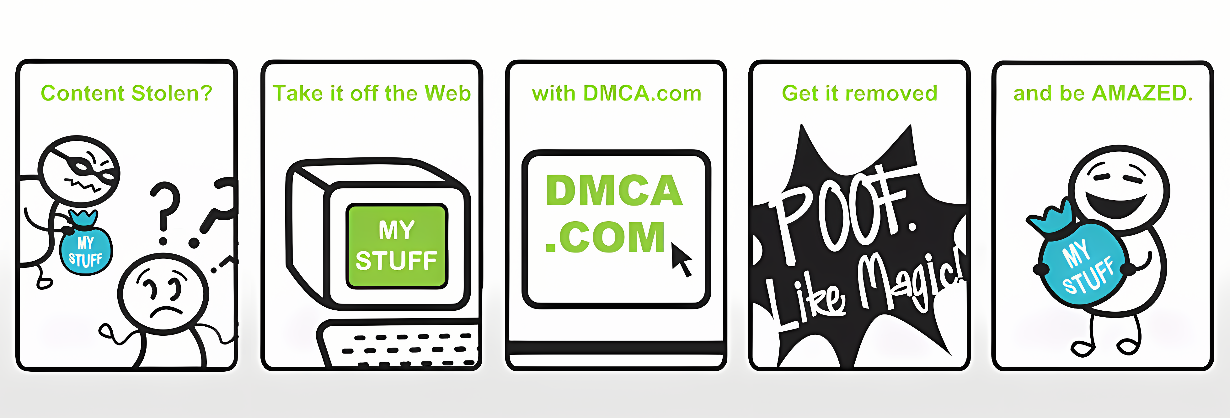
The goddamn DMCA

Slide 58
The goddamn DMCA
It all goes to the publishers, not creators!

Slide 59

It is a war behind the scene
Gottfrid Svartholm

Slide 60
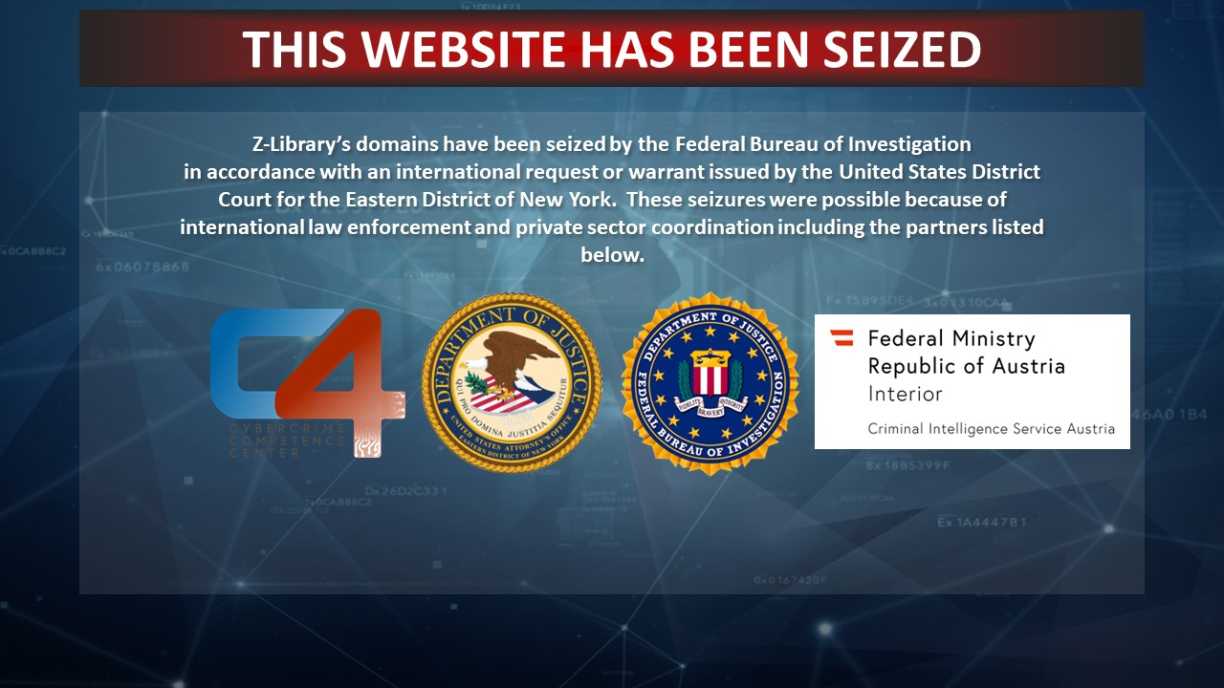

Slide 61


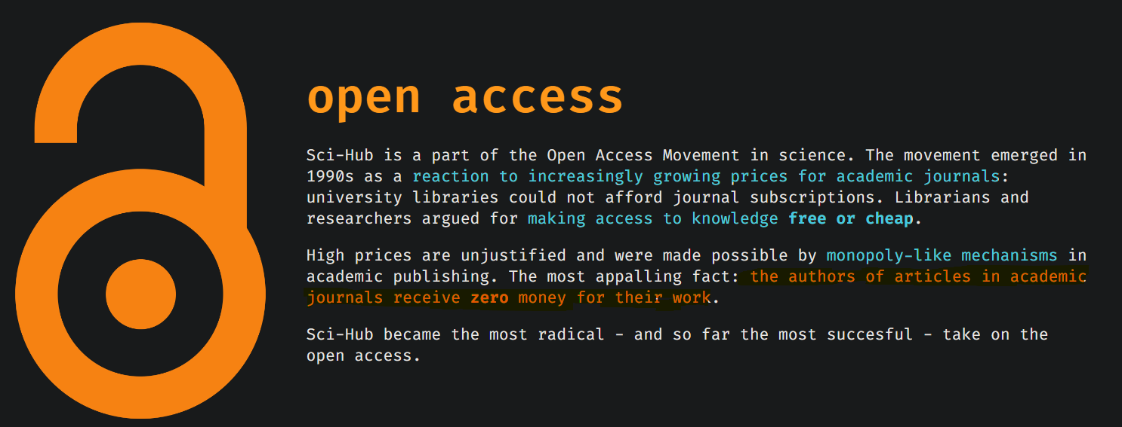
Alexandra Elbakyan

Slide 62
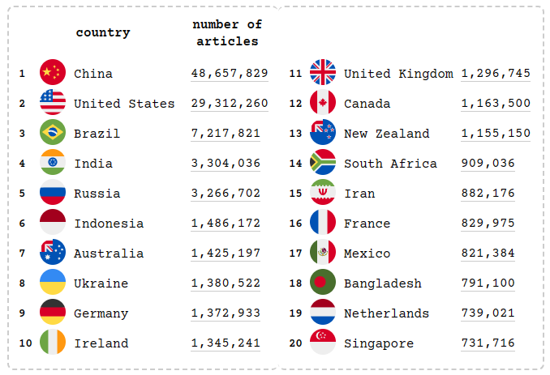
The table shows countries that downloaded most papers from Sci-Hub in the last month, ordered by number of downloads.

Slide 63
Practical Examples
Sci-Hub: already introduced
Anna’s archive: replacement for Z-library
NewPipe, Revanced, and ReturnYouTubeDislike: “fix” YouTube
Media:
TorrentGalaxy: Movies, games, software, music, TV series, etc.
Fmovies: Replacement for all streaming services (video)
Moderated and verified wikis and resources:
r/piracy
r/piracy megathread
4chan

Slide 64
Practical Examples
Sci-Hub: already introduced
Anna’s archive: replacement for Z-library
NewPipe, Revanced, and ReturnYouTubeDislike: “fix” YouTube
Media:
TorrentGalaxy: Movies, games, software, music, TV series, etc.
Fmovies: Replacement for all streaming services (video)
Moderated and verified wikis and resources:
r/piracy
r/piracy megathread
4chan

Slide 65
Practical Examples
Sci-Hub: already introduced
Anna’s archive: replacement for Z-library
NewPipe, Revanced, and ReturnYouTubeDislike: “fix” YouTube
Media:
TorrentGalaxy: Movies, games, software, music, TV series, etc.
Fmovies: Replacement for all streaming services (video)
Moderated and verified wikis and resources:
r/piracy
r/piracy megathread
4chan

Slide 66
Practical Examples
Sci-Hub: already introduced
Anna’s archive: replacement for Z-library
NewPipe, Revanced, and ReturnYouTubeDislike: “fix” YouTube
Media:
TorrentGalaxy: Movies, games, software, music, TV series, etc.
Fmovies: Replacement for all streaming services (video)
Moderated and verified wikis and resources:
r/piracy
r/piracy megathread
4chan

Slide 67
Practical Examples
Sci-Hub: already introduced
Anna’s archive: replacement for Z-library
NewPipe, Revanced, and ReturnYouTubeDislike: “fix” YouTube
Media:
TorrentGalaxy: Movies, games, software, music, TV series, etc.
Fmovies: Replacement for all streaming services (video)
Moderated and verified wikis and resources:
r/piracy
r/piracy megathread
4chan

Slide 68
Practical Examples
Sci-Hub: already introduced
Anna’s archive: replacement for Z-library
NewPipe, Revanced, and ReturnYouTubeDislike: “fix” YouTube
Media:
TorrentGalaxy: Movies, games, software, music, TV series, etc.
Fmovies: Replacement for all streaming services (video)
Moderated and verified wikis and resources:
r/piracy
r/piracy megathread
4chan

Slide 69
Practical Examples
Sci-Hub: already introduced
Anna’s archive: replacement for Z-library
NewPipe, Revanced, and ReturnYouTubeDislike: “fix” YouTube
Media:
TorrentGalaxy: Movies, games, software, music, TV series, etc.
Fmovies: Replacement for all streaming services (video)
Moderated and verified wikis and resources:
r/piracy
r/piracy megathread
4chan

Slide 70
Practical Examples
Sci-Hub: already introduced
Anna’s archive: replacement for Z-library
NewPipe, Revanced, and ReturnYouTubeDislike: “fix” YouTube
Media:
TorrentGalaxy: Movies, games, software, music, TV series, etc.
Fmovies: Replacement for all streaming services (video)
Moderated and verified wikis and resources:
r/piracy
r/piracy megathread
4chan

Slide 71
Practical Examples
Sci-Hub: already introduced
Anna’s archive: replacement for Z-library
NewPipe, Revanced, and ReturnYouTubeDislike: “fix” YouTube
Media:
TorrentGalaxy: Movies, games, software, music, TV series, etc.
Fmovies: Replacement for all streaming services (video)
Moderated and verified wikis and resources:
r/piracy
r/piracy megathread
4chan

Slide 72
Practical Examples
Sci-Hub: already introduced
Anna’s archive: replacement for Z-library
NewPipe, Revanced, and ReturnYouTubeDislike: “fix” YouTube
Media:
TorrentGalaxy: Movies, games, software, music, TV series, etc.
Fmovies: Replacement for all streaming services (video)
Moderated and verified wikis and resources:
r/piracy
r/piracy megathread
4chan

Slide 73
Practical Examples

Slide 74
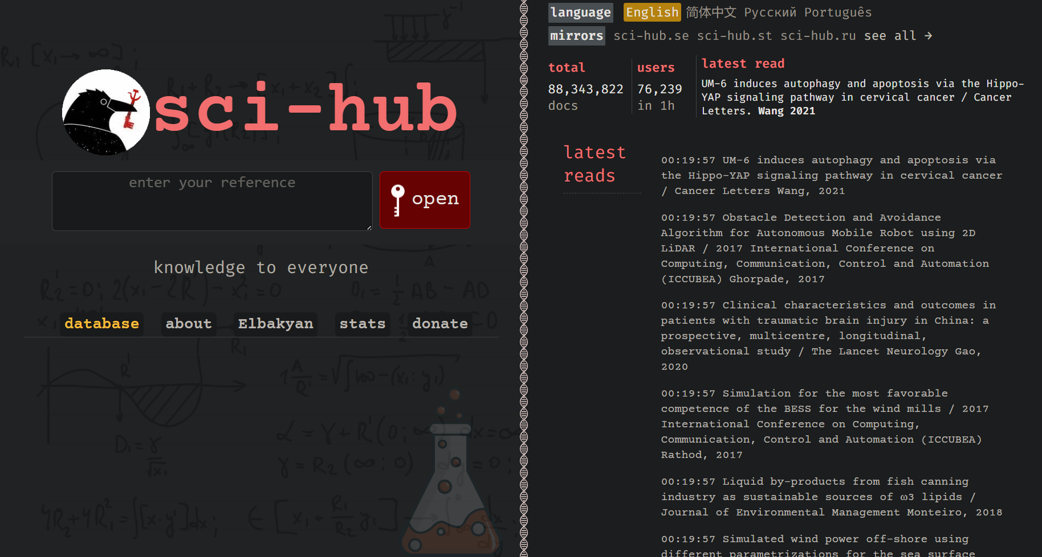

Slide 75
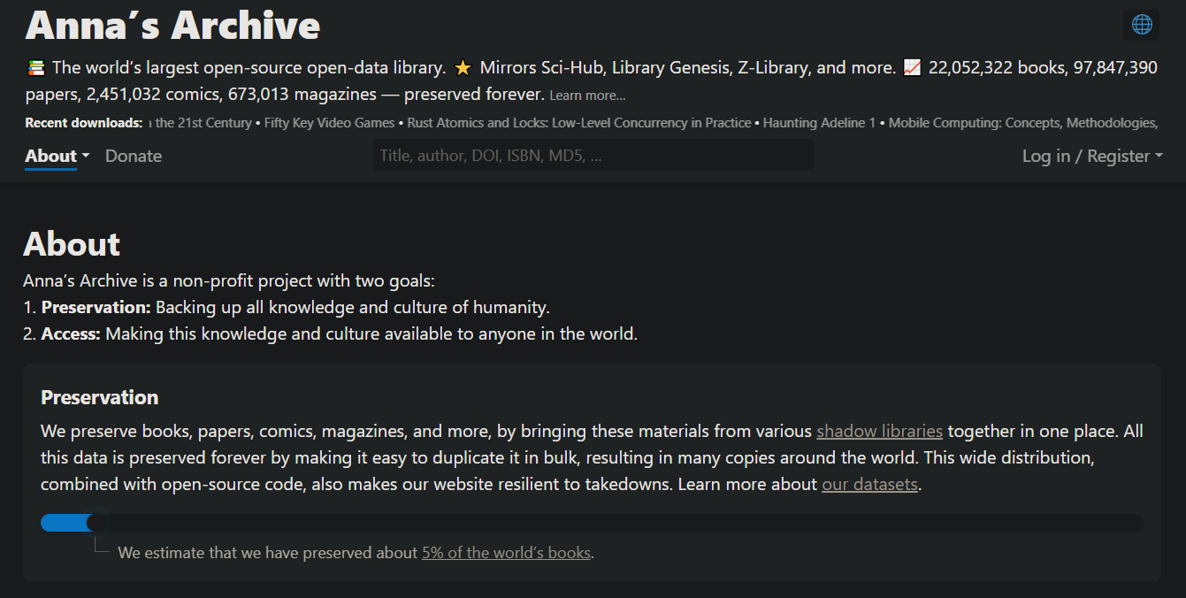

Slide 76
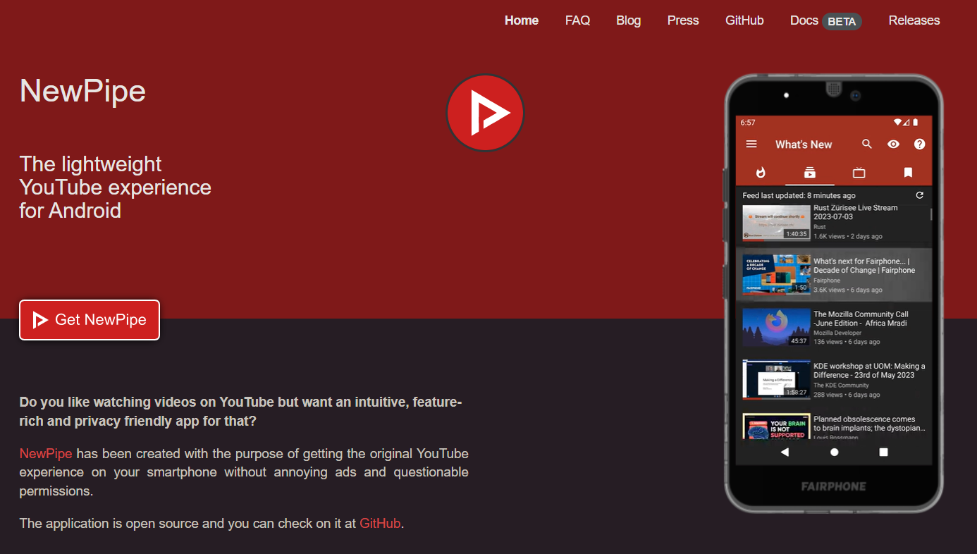

Slide 77
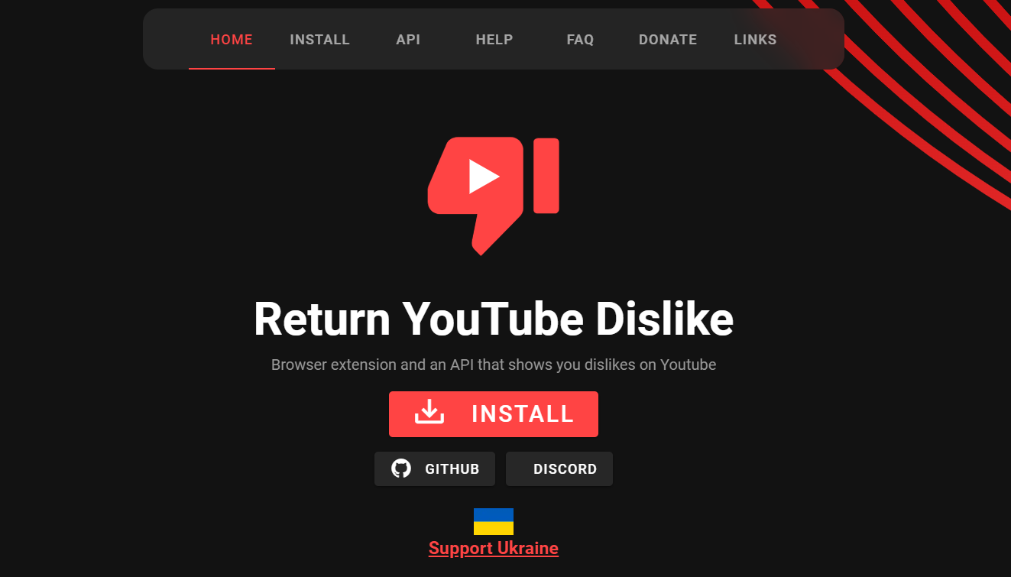

Slide 78
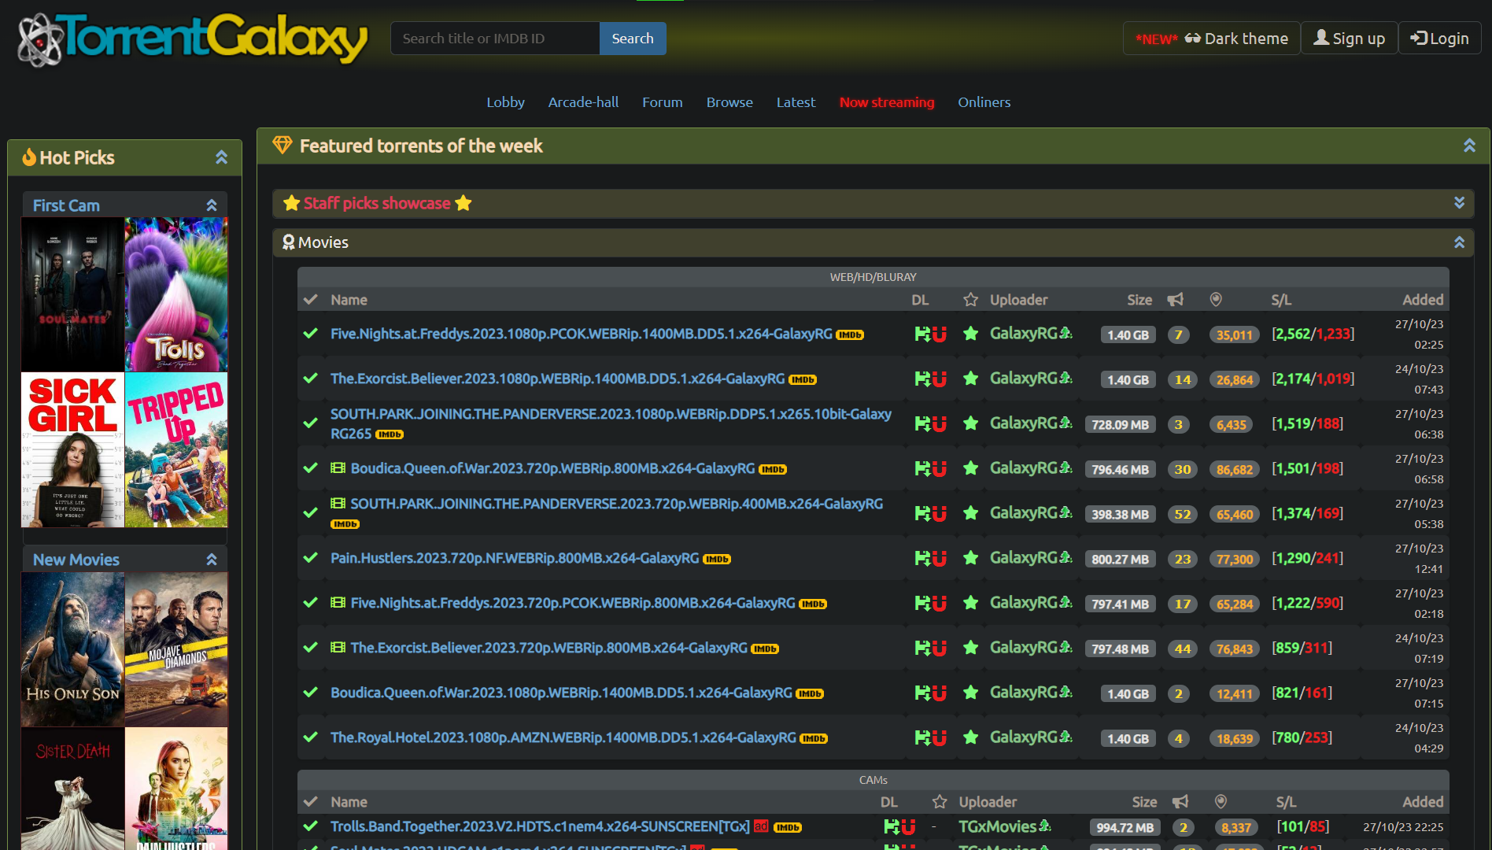

Slide 79
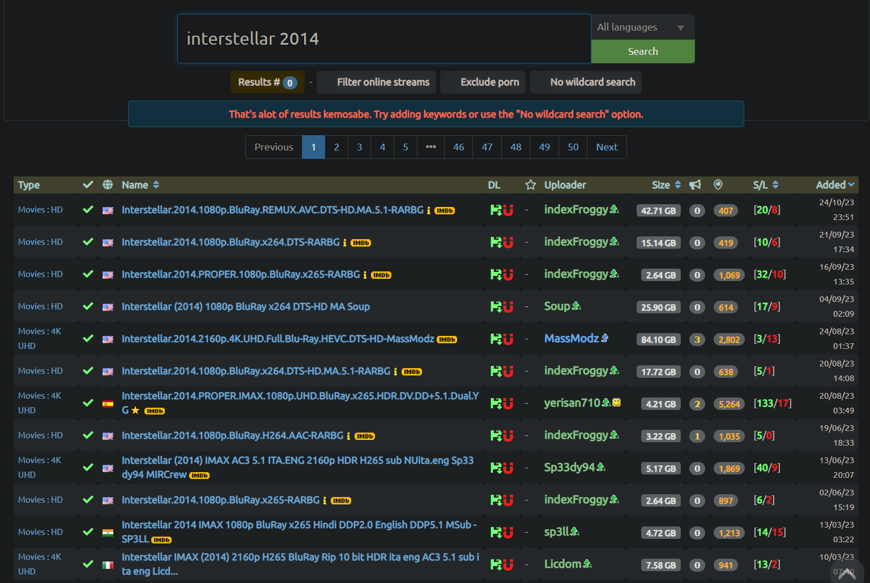

Slide 80
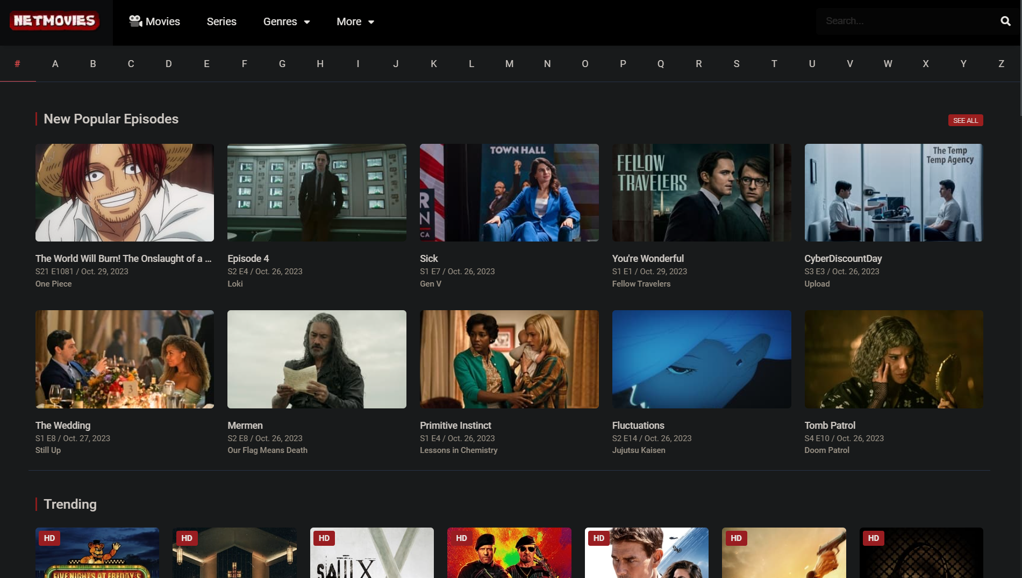

Slide 81
Last Thoughts

Slide 82
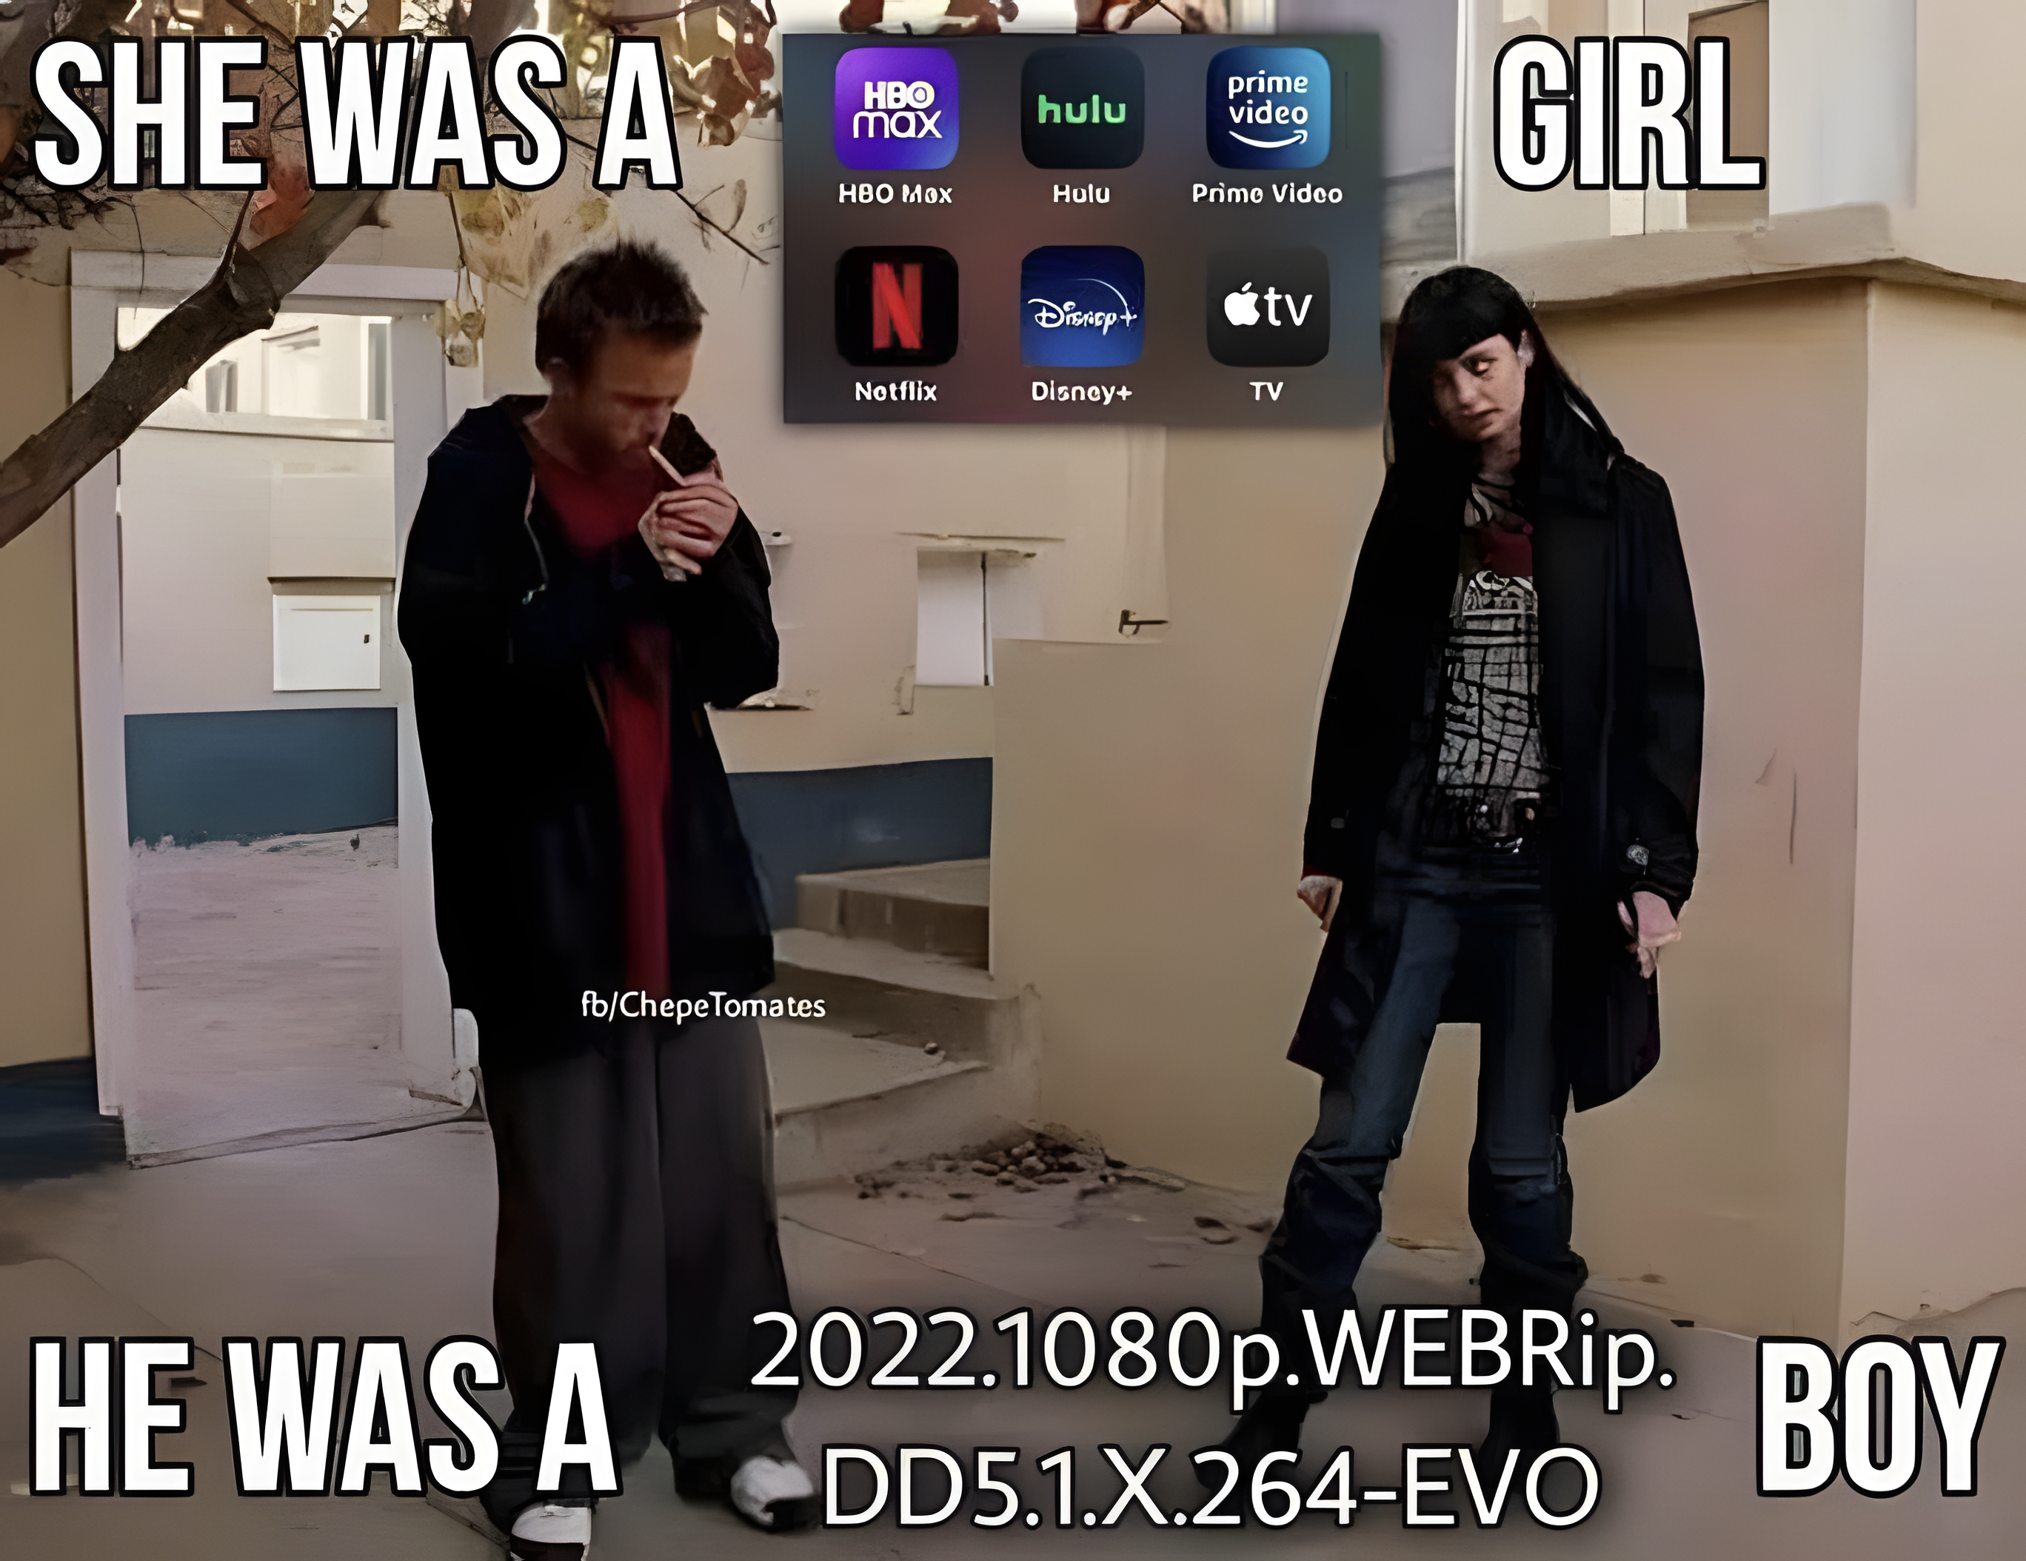
You might look like a creep for “over”-complicating stuff

Slide 83
We as Iranians, for just the sake of censorship and not being affected by DMCA, should use it

Slide 84
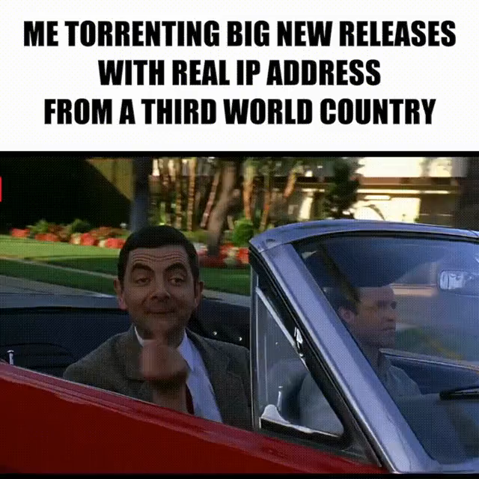
We as Iranians, for just the sake of censorship and not being affected by DMCA, should use it

Slide 85
It is a “people for the people” fight; please provide as much as you consume; SEED the torrents

Slide 86
Thank you

